Slide 1
Measuring feature expansion for generative-based image data augmentation
Introduction

Slide 2
Introduction: why data augmentation
Problems: Expensive to collect-- Limited data, Class imbalance…
Solution: Data augmentation--basic image transformation, DL-based oversampling method…

Slide 3
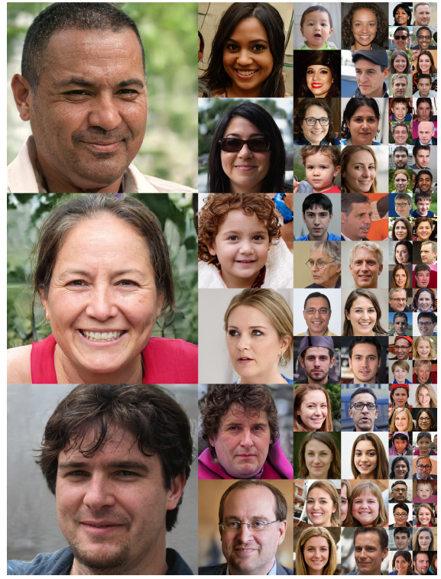
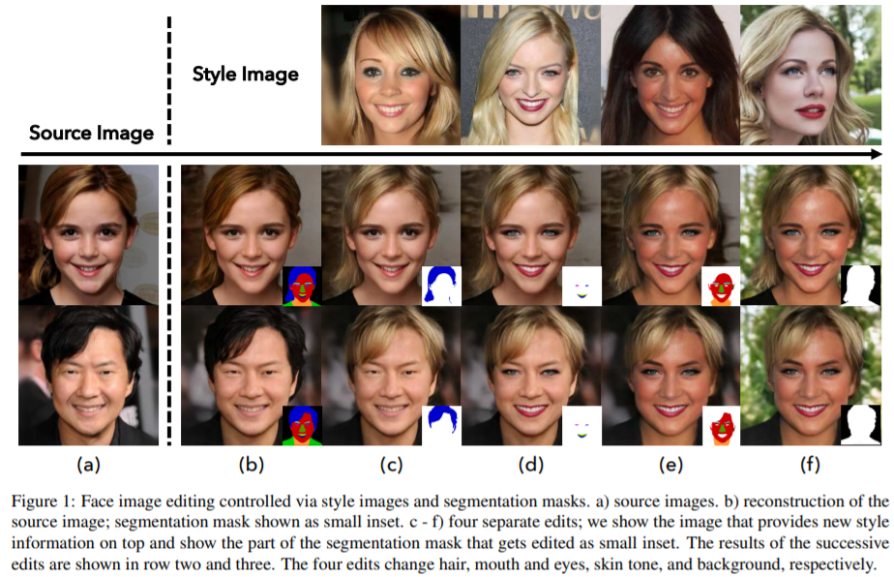
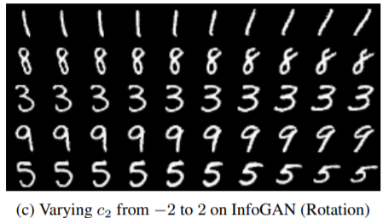
Semantic feature augmentation with DL-based Method
InfoGAN: Chen et al., 2016
StyleGAN: Karras et al. ,2019
SEAN: Zhu et al., 2020
Semantic feature interpolation
style-mixing
Local semantic control

Slide 4
Question: as more and more semantic augmentation methods are investigated…
How do we know if the semantic augmentation is effective?
How to measure?
FID: Inception Network-based, to compare the original and the generated distribution, but when new feature appear?
IS: Entropy p(y|x) smaller; entropy p(y) bigger - Model collapse
They measure the diversity and the quality of the images, but has not consider the semantic expansion after augmentation.
Call for a more reasonable model to measure feature augmentation especially for generative models.

Slide 5
FID and FIS measure the diversity and the quality of the images, but has not consider the semantic expansion after augmentation.
Call for a more reasonable model to measure feature augmentation especially for generative models.

Slide 6
Central question: how do we measure feature-based augmentation method?
How do generative models augment the original dataset?
How do we know if the augmentation is effective?

Slide 7
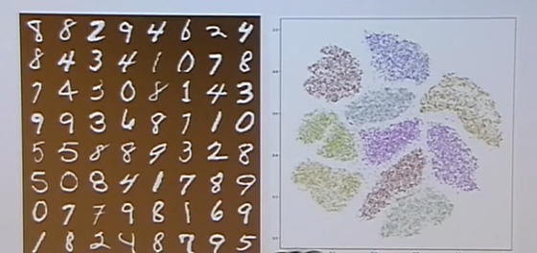
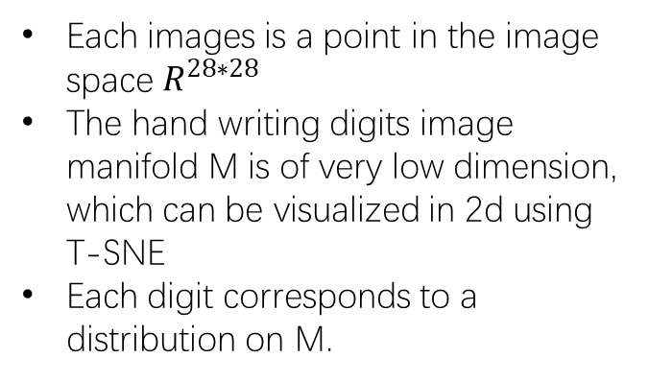
How do generative models augment data?
Manifold Learning Hypothesis
Each images is a point in the image space $R^{28∗28}$
The hand writing digits image manifold M is of very low dimension, which can be visualized in 2d using T-SNE
Each digit corresponds to a distribution on M.
A 2d data manifold representation for Minst
People can cheat on this!
Source: An Optimal Transportation (OT) View of Generative Adversarial Networks:
http://www.ipam.ucla.edu/abstract/?tid=15873

Slide 8
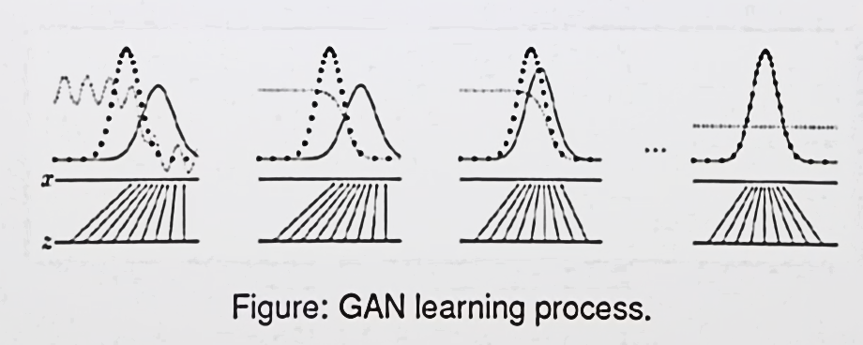
How do generative models augment data?
generative model, transfer uniform distribution (in latent space) to the original data distribution on the manifold.
(An et al.,2020) AE-OT-GAN
Source: An Optimal Transportation (OT) View of Generative Adversarial Networks:
http://www.ipam.ucla.edu/abstract/?tid=15873

Slide 9
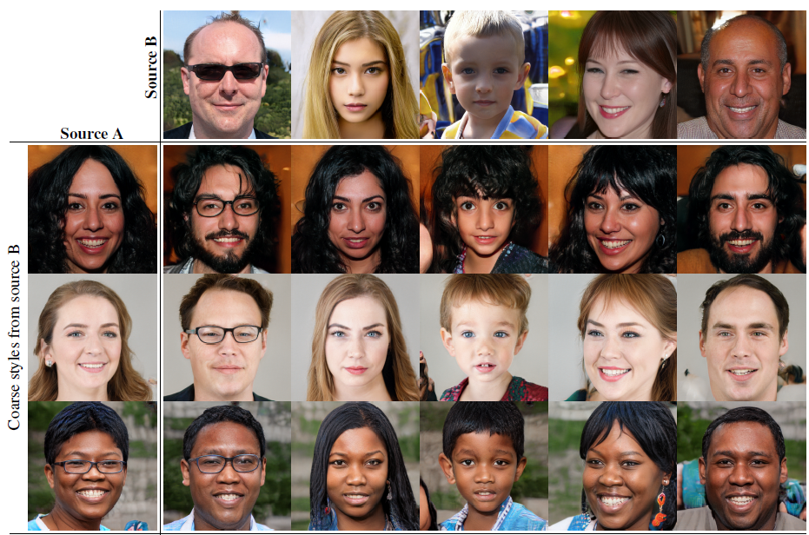
How do generative models augment data?
Feature-based augmentation: oversampling the learned manifold two operation
Interpolation
Extrapolation (style mixing)
InfoGAN: Chen et al., 2016
StyleGAN: Karras et al. ,2019

Slide 10
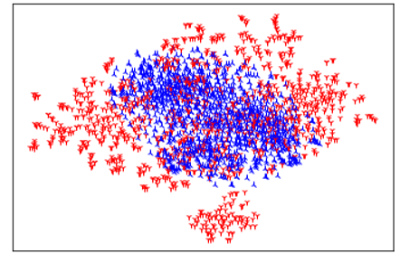
Central question: how do we measure feature-based augmentation method?
Map the data into a feature space (like manifold) that has:
Between-class Separability : each class constrained in a subspace
In-class linearity: semantic linearity in one class - interpolation
In-class convexity : new feature -> outside the class distribution
Compare the distribution before and after augmentation
Figure: Comparison of Latent space distribution before (blue) and after (red) style-mixing on CelebA

Slide 11
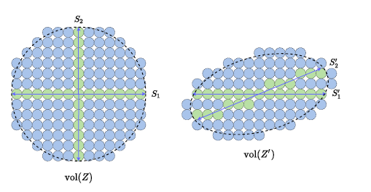
Find semantic feature space
Representation learning
Learning Diverse and Discriminative Representations
via the Principle of Maximal Coding Rate Reduction
Learn more on this, an alternative
Ha, M. L., Franchi, G., Aldea, E., & Blanz, V. (2021). Learning a Discriminant Latent Space with Neural Discriminant Analysis. arXiv preprint arXiv:2107.06209.
(Yu et al., 2020)

Slide 12
Experiment Design
1 Verification of the property of the semantic feature space
Between-class Separability: distance between centers of each cluster
In-class linearity: visualization feature space -> image space
In-class convexity: comparison of distribution after hand-added feature. Visualization.

Slide 13
Experiment Design
1 Verification of the property of the semantic feature space
2 Test the effectiveness of generative–based augmentation method
3 A overall test on various generative method and latent space techniques to guide the selection of GANs in data augmentation.

Slide 14
Reference
Zhu, P., Abdal, R., Qin, Y., & Wonka, P. (2020). Sean: Image synthesis with semantic region-adaptive normalization. In Proceedings of the IEEE/CVF Conference on Computer Vision and Pattern Recognition (pp. 5104-5113).
Karras, T., Laine, S., & Aila, T. (2019). A style-based generator architecture for generative adversarial networks. In Proceedings of the IEEE/CVF Conference on Computer Vision and Pattern Recognition (pp. 4401-4410).
Chen, X., Duan, Y., Houthooft, R., Schulman, J., Sutskever, I., & Abbeel, P. (2016, December). Infogan: Interpretable representation learning by information maximizing generative adversarial nets. In Proceedings of the 30th International Conference on Neural Information Processing Systems (pp. 2180-2188).

Slide 15
Reference
An, D., Guo, Y., Zhang, M., Qi, X., Lei, N., & Gu, X. (2020, August). AE-OT-GAN: Training GANs from data specific latent distribution. In European Conference on Computer Vision (pp. 548-564). Springer, Cham.
Yu, Y., Chan, K. H. R., You, C., Song, C., & Ma, Y. (2020). Learning diverse and discriminative representations via the principle of maximal coding rate reduction. Advances in Neural Information Processing Systems, 33.

Slide 16
Questions
What is the advantage of generative models in data augmentation? Especially compared to various mixing techniques? Mixed Sample Data Augmentation? Harris, E., Marcu, A., Painter, M., Niranjan, M., Prügel-Bennett, A., & Hare, J. (2020). Fmix: Enhancing mixed sample data augmentation. arXiv preprint arXiv:2002.12047.
What is the goal of the data augmentation, for classification? For domain adaptation? Why not evaluate with the performance on the task? What is the advantage of the proposed evaluation method.

